Slide 1
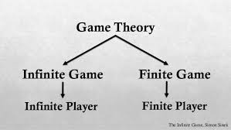
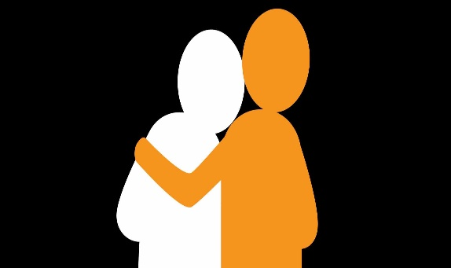
Understanding Empathy
Are you OK, I am worried about you
Trending
I have no doubt
Compete against yourself
How can I do better than I did yesterday
I cant simply say to someone to trust me and you will
We don’t care how hard you work or how long you have worked here
Create a word bank for discussion
What criteria do we use to measure a company? Now think of another one
Take an infinite mindset!
Finite game – to win
Infinite game – keep the game going
Obsessed with competition Vs obsessed with where we are going
Be a great leader – Change your perspective and play the game you are actually playing
To be a great leader, start with empathy
Should a coach Prioritise the needs of the fans over that of the players?
Christopher Bauman – www.chrisbauman.com.au

Slide 2
1. Empathy (What is it?)
____________________________________________________________________________________________?
Advanced Question Words
2. Responsible for the people who are responsible for the job ___________________________________________________________________________________________ ?
Relate to what others are going through
Status
Position
Lies, hides and fakes
3. Leadership comes at great personal sacrifice ___________________________________________________________________________________________ ?
To Stir the pot
Perspective
4 When something goes wrong, instead of yelling, say ‘try again’ ___________________________________________________________________________________________ ?
Be concerned about the human being, not just their output
5. Tell a story about the service you received when you stayed somewhere ___________________________________________________________________________________________ ?
Keep my head under the radar
6. How is your job going and is there anything that we can do to make your job better? ___________________________________________________________________________________________ ?
I need help
What is someone else going through
7. What are the consequences in an organisation where employees are afraid? ___________________________________________________________________________________________ ?
Side Effects
8. How do I help my people be at their natural best __________________________________________________________________________________ ?
Create environments that are safe enough for someone to say, I don’t know what I am doing
Christopher Bauman – www.chrisbauman.com.au

